Slide 1
Credit EDA Case study
Student name : Roshan Chandru

Slide 2
Problem statement:
Two types of risks are associated with the bank’sdecision:
● If the applicant is likely to repay the loan, then not approving the loan results in a loss of business to the company.
● If the applicant is not likely to repay the loan, i.e. he/she is likely to default, then approving the loan may lead to a financial loss for the company.
Steps involved:
Understanding the Data
Import / load the data
Check the structure / metadata of the data
Missing value check
Outliner check
Perform Univariant Analysis
Perform segmented univariate analysis
Perform Bivariate analysis

Slide 3
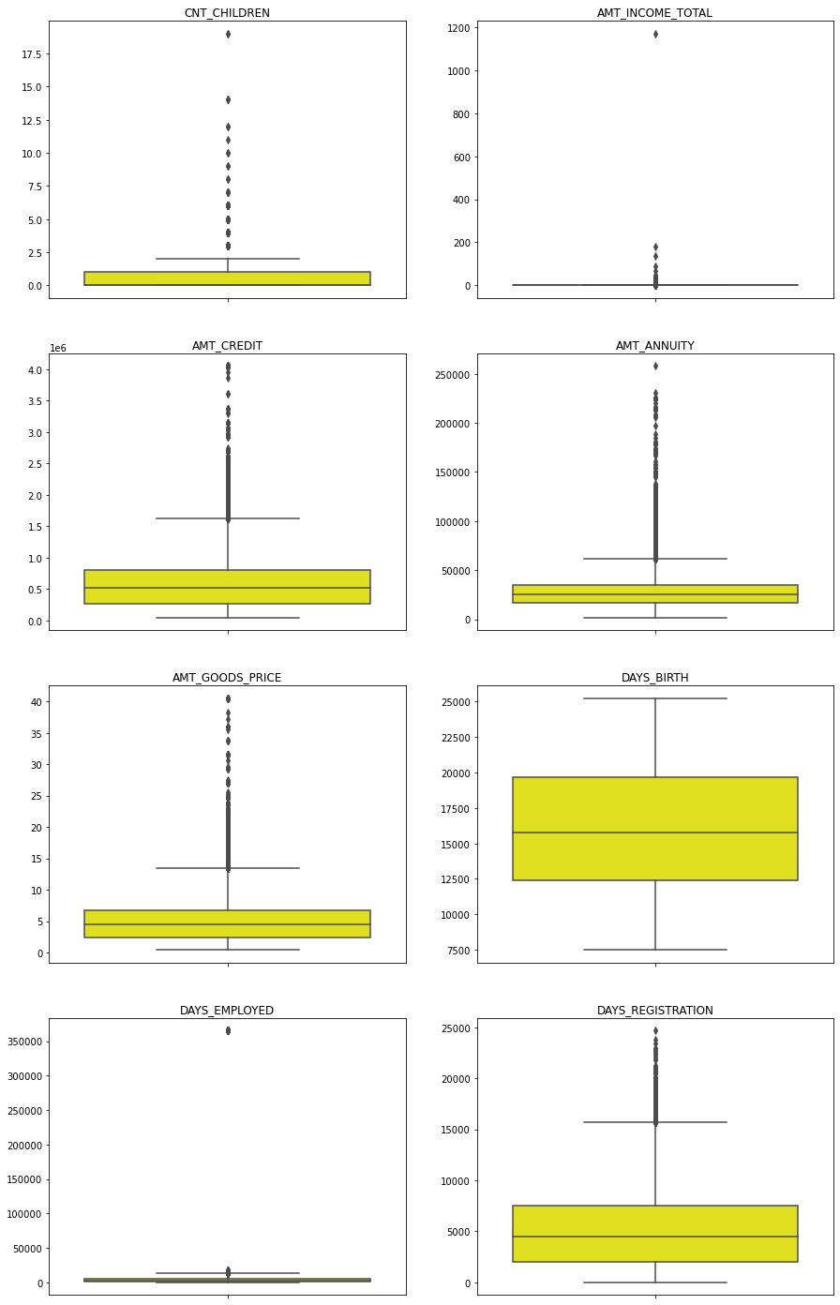
Identifying Outliers: application_data
1. AMT_ANNUITY, AMT_CREDIT, AMT_GOODS_PRICE,CNT_CHILDREN have some number of outliers.
2. AMT_INCOME_TOTAL has huge number of outliers which indicate that few of the loan applicants have high income when compared to the others.
3. DAYS_BIRTH has no outliers.
4. DAYS_EMPLOYED has outlier values around 350000(days) which is around 958 years which is impossible and hence this has to be incorrect entry.¶

Slide 4
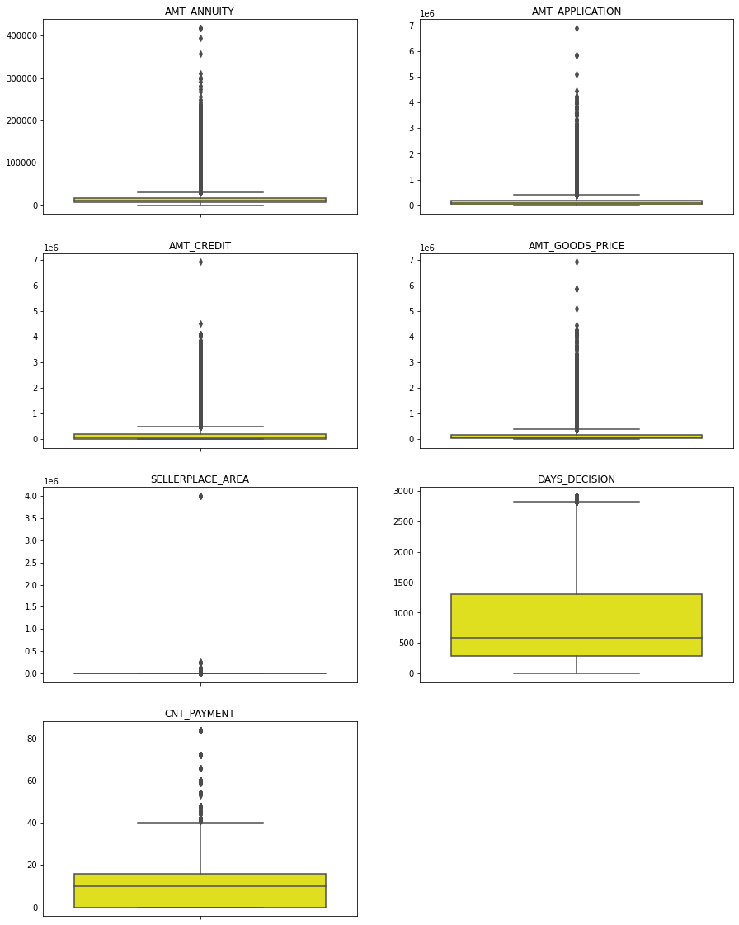
Identifying Outliers: application_data
1. AMT_ANNUITY, AMT_APPLICATION, AMT_CREDIT, AMT_GOODS_PRICE, SELLERPLACE_AREA have huge number of outliers.
2. CNT_PAYMENT has few outlier values.
3. DAYS_DECISION has little number of outliers indicating that these previous applications decisions were taken long back.

Slide 5
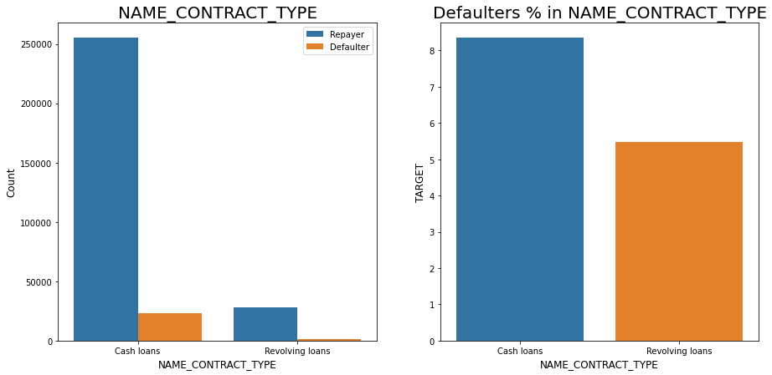
Data Analysis: 1. Categorical Variables Analysis 1.a Segmented Univariate Analysis
Fig : Checking the contract type based on loan repayment status

Slide 6
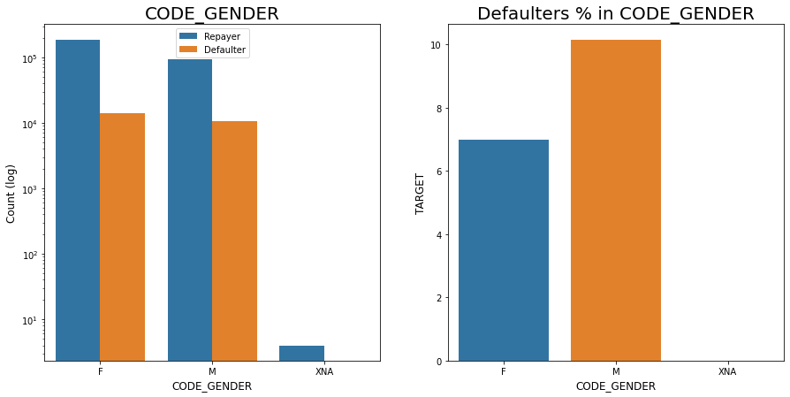
Fig : Checking the type of Gender on loan repayment status

Slide 7
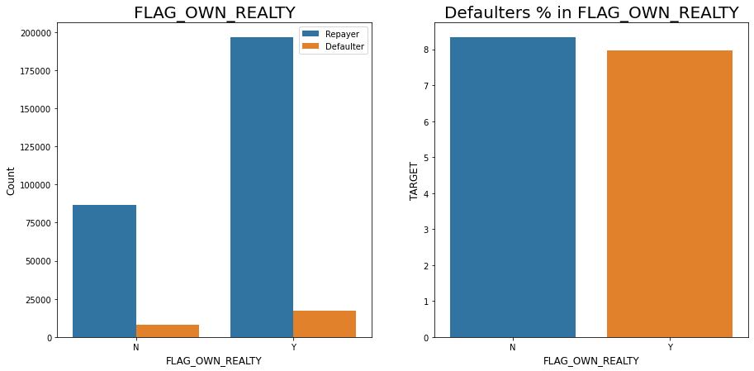
Fig : Checking if owning a real estate is related to loan repayment status

Slide 8
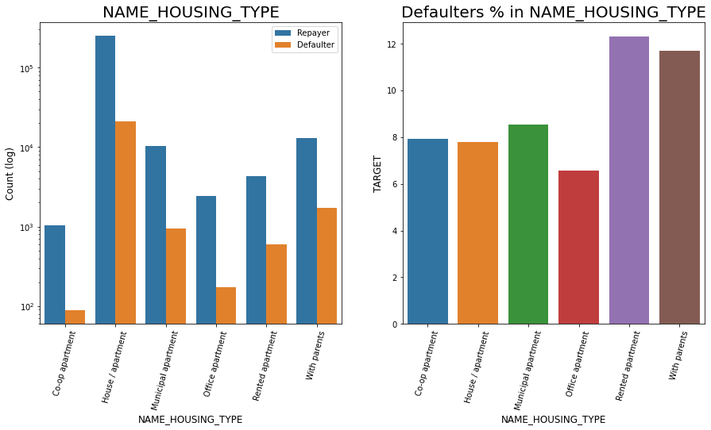
Fig : Analyzing Housing Type based on loan repayment status

Slide 9
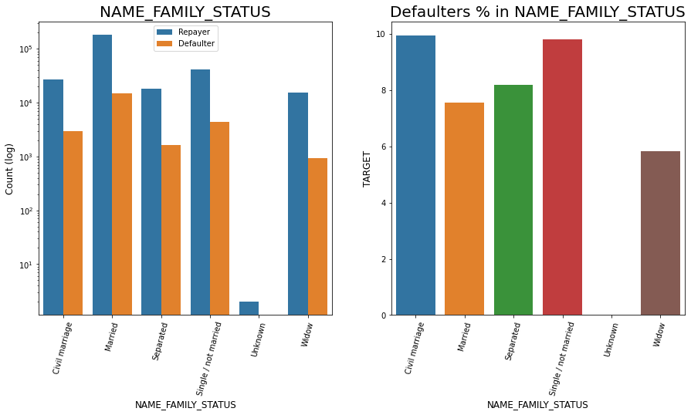
Fig : Analyzing Family status based on loan repayment status

Slide 10
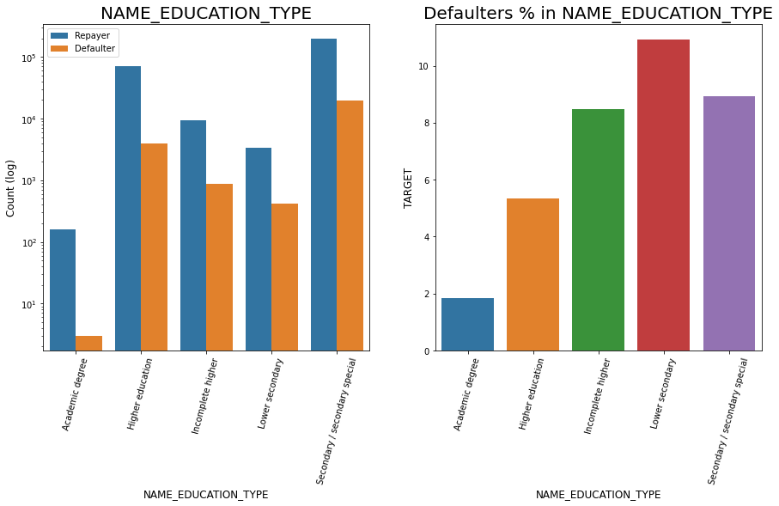
Fig : Analyzing Education Type based on loan repayment status

Slide 11
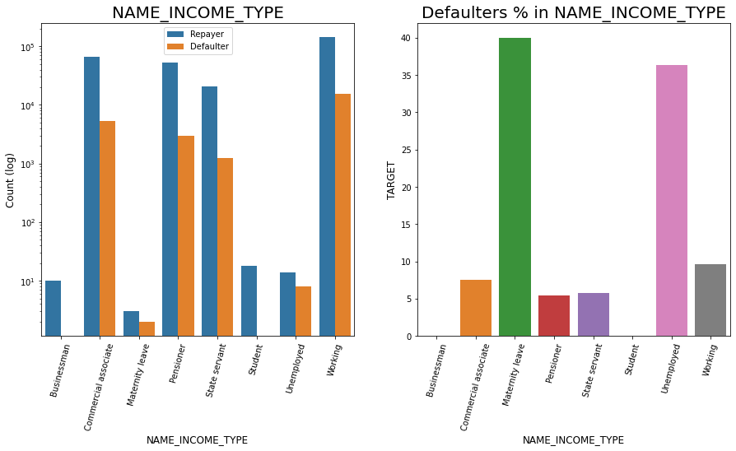
Fig : Analyzing Income Type based on loan repayment status

Slide 12
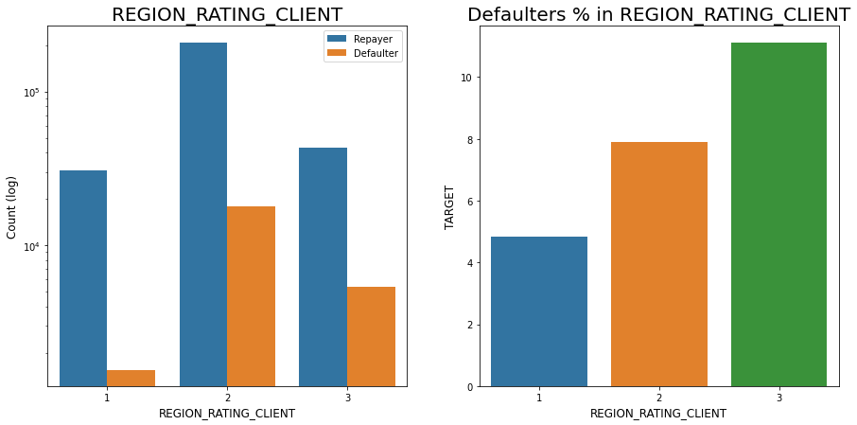
Fig : Analyzing Region rating where applicant lives based on loan repayment status

Slide 13
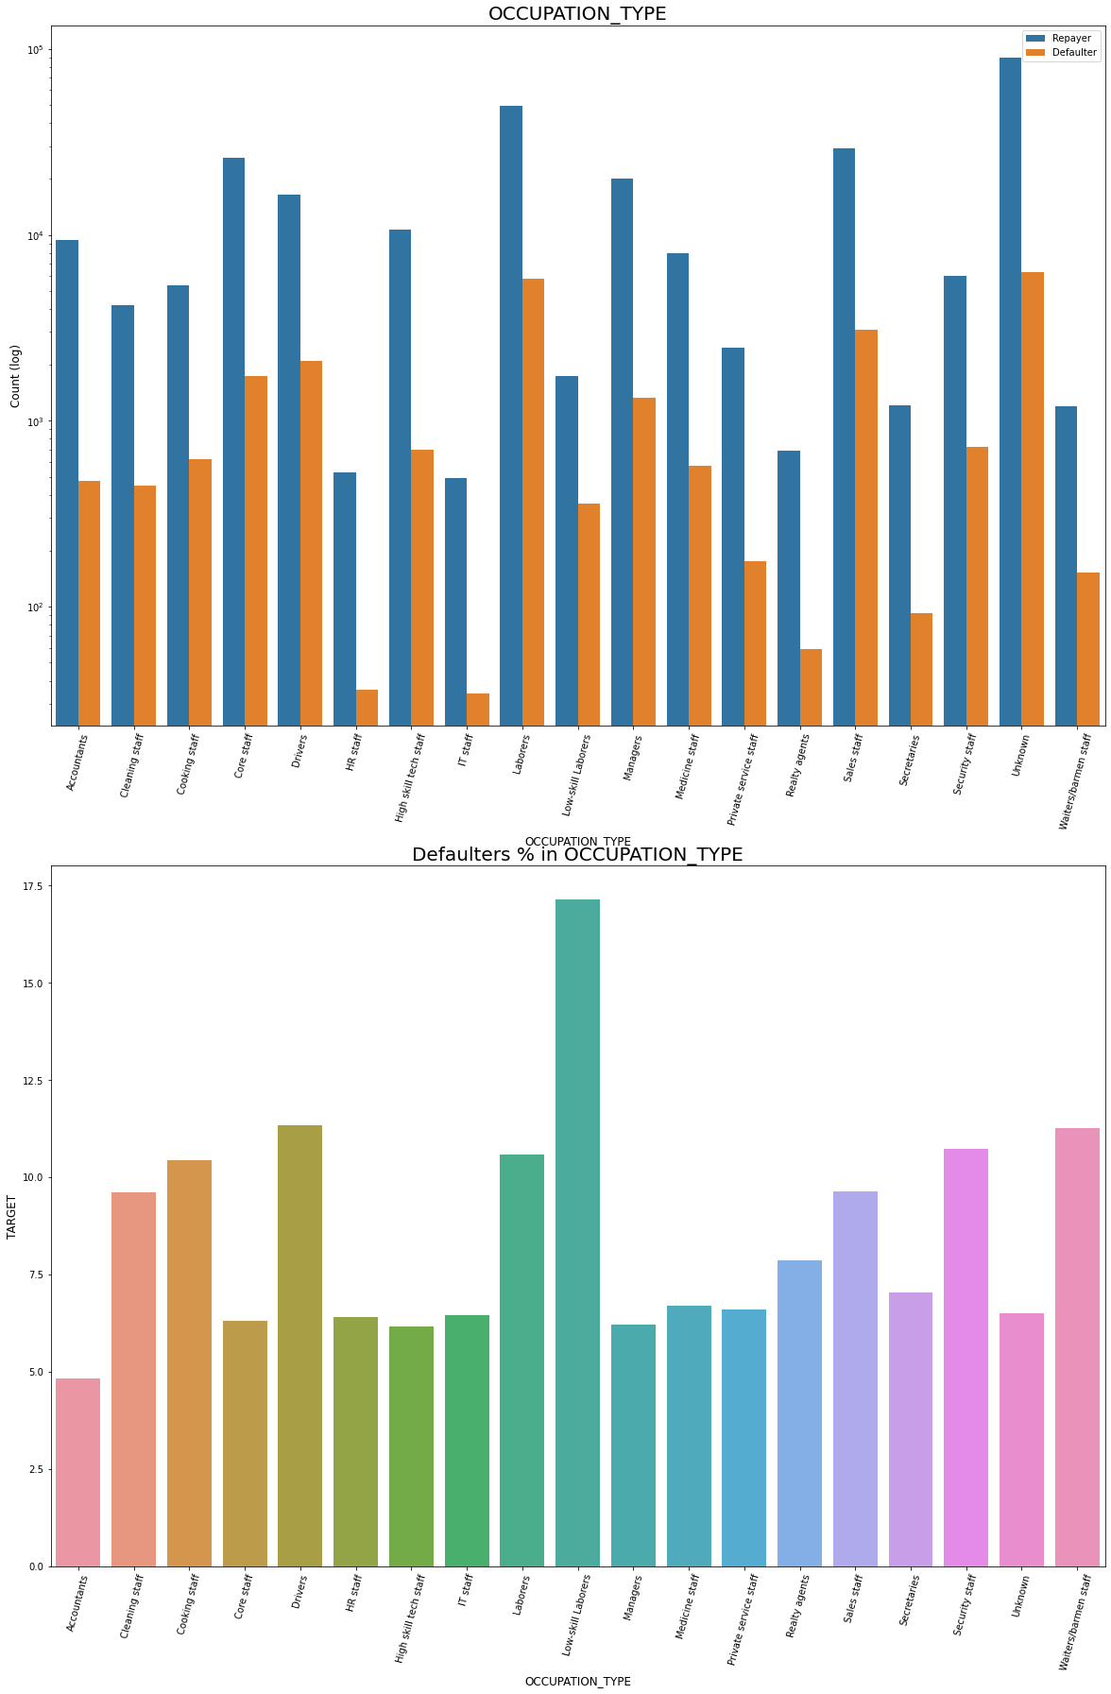
Fig : Analyzing Occupation Type where applicant lives based on loan repayment status
Inferences:
Most of the loans are taken by Laborers, followed by Sales staff.
IT staff are less likely to apply for Loan.
Category with highest percent of defautess are Low-skill Laborers (above 17%), followed by Drivers and Waiters/barmen staff, Security staff, Laborers and Cooking staff

Slide 14
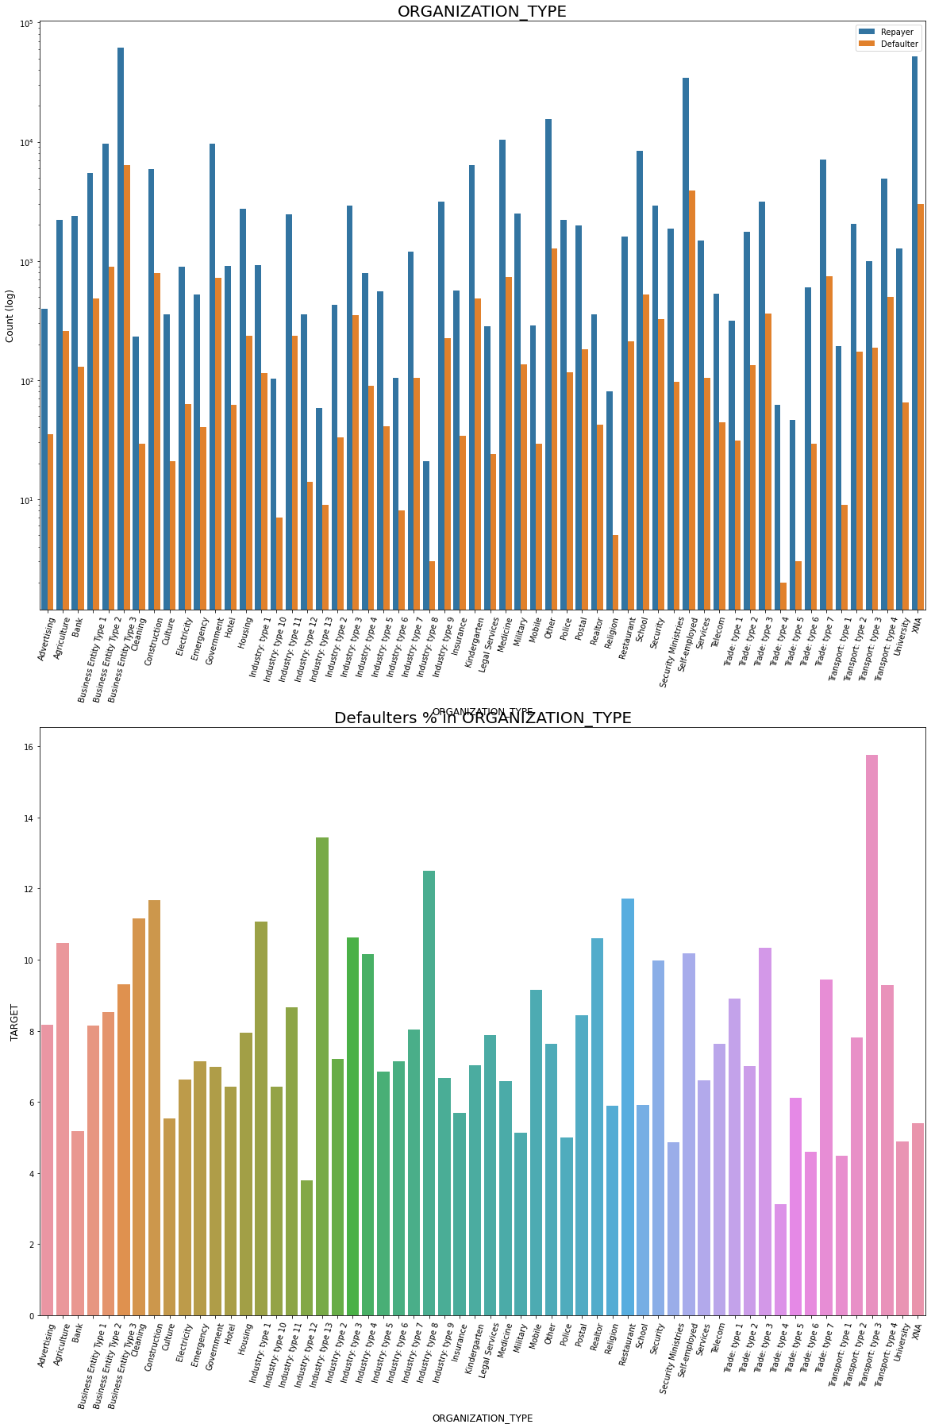
Fig : Checking Loan repayment status based on Organization type
Inferences: Organization Type
Organizations with highest percent of defaultess are Transport: type 3 (16%), Industry: type 13 (13.5%), Industry: type 8 (12.5%) and Restaurant (less than 12%).
Self employed people have relative high defaulting rate,to be safer side loan disbursement should be avoided or provide loan with higher interest rate to mitigate the risk of defaulting.
Most of the people application for loan are from Business Entity Type 3
For a very high number of applications, Organization type information is unavailable(XNA)
It can be seen that following category of organization type has lesser defaulters thus safer for providing loans: Trade Type 4 and 5, Industry type 8

Slide 15
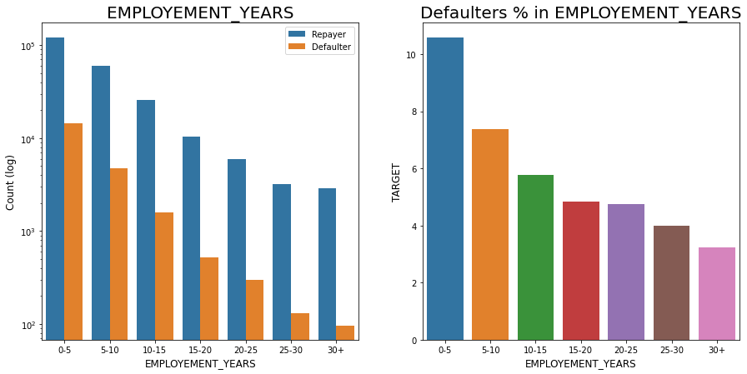
Fig : Analyzing Employment_Year based on loan repayment status
Inferences: Employment in Years
Majority of the applicants having working experience between 0-5 years are defaultees. The defaulting rating of this group is also the highest which is around 10%
With increase of employment year, defaulting rate is radually decreasing.
with people having 40+ year experience have less than 1% default rate

Slide 16
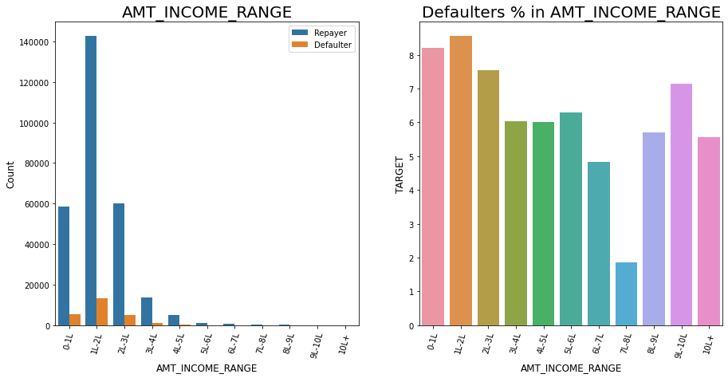
Fig : Analyzing Amount_Income Range based on loan repayment status
Inferences: Loan Amount
there are high number of applicants have loan in range of 2-3 Lakhs followed by 10 Lakh above range
People who get loan for 3-6 Lakhs have most number of defaulters than other loan range.

Slide 17
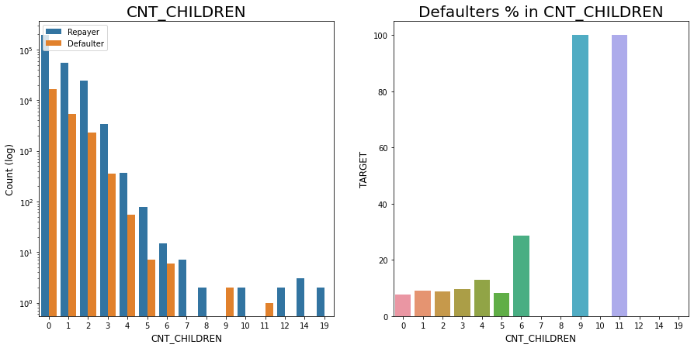
Fig : Analyzing Number of children based on loan repayment status
Inferences: Client Children's Count
Most of the applicants do not have children
Very few clients have more than 3 children.
Client who have more than 4 children has a very high default rate with child count 9 and 11 showing 100% default rate

Slide 18
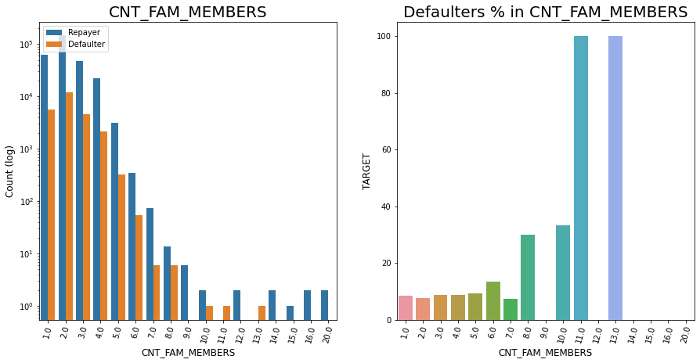
Fig : Analyzing Number of family members based on loan repayment status
Inferences: Family Memembers Count
Family member follows the same trend as children where having more family members increases the risk of defaulting

Slide 19
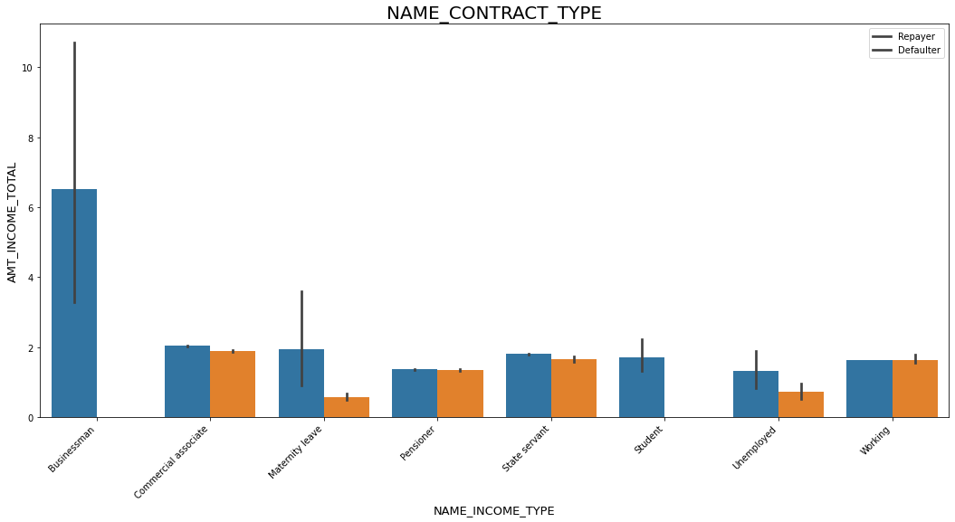
1.b Categorical Bivariate or Multivariate Analysis
Fig : Income type vs Income Amount Range on a Seaborn Barplot
Inferences:
It can be seen that Businessman income is the highest and the estimated range with default 95% confidence level seem to indicate that the income of a Businessman could be in the range of slightly close to 4 lakhs and slightly above 10 lakhs

Slide 20
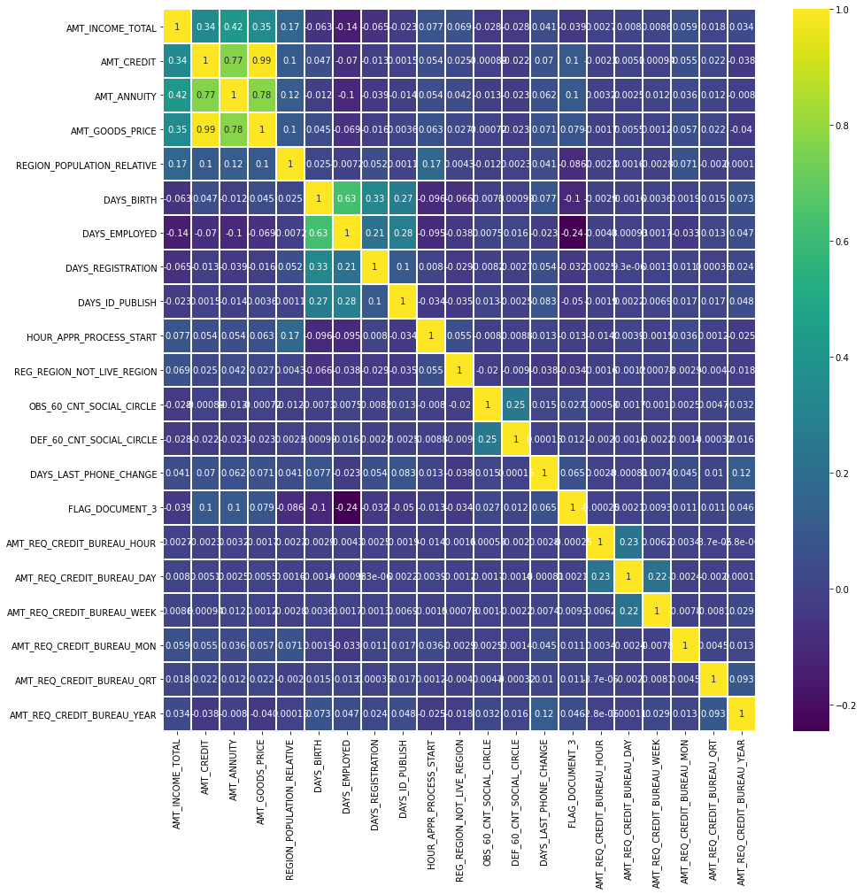
1.c Numeric Variables Analysis
Inferences: Correlating factors amongst repayers
Credit amount is highly correlated with:
Goods Price Amount
Loan Annuity
Total Income
2. We can also see that repayers have high correlation in number of days employed.
Fig : plotting heatmap to see linear correlation amoung Repayers

Slide 21
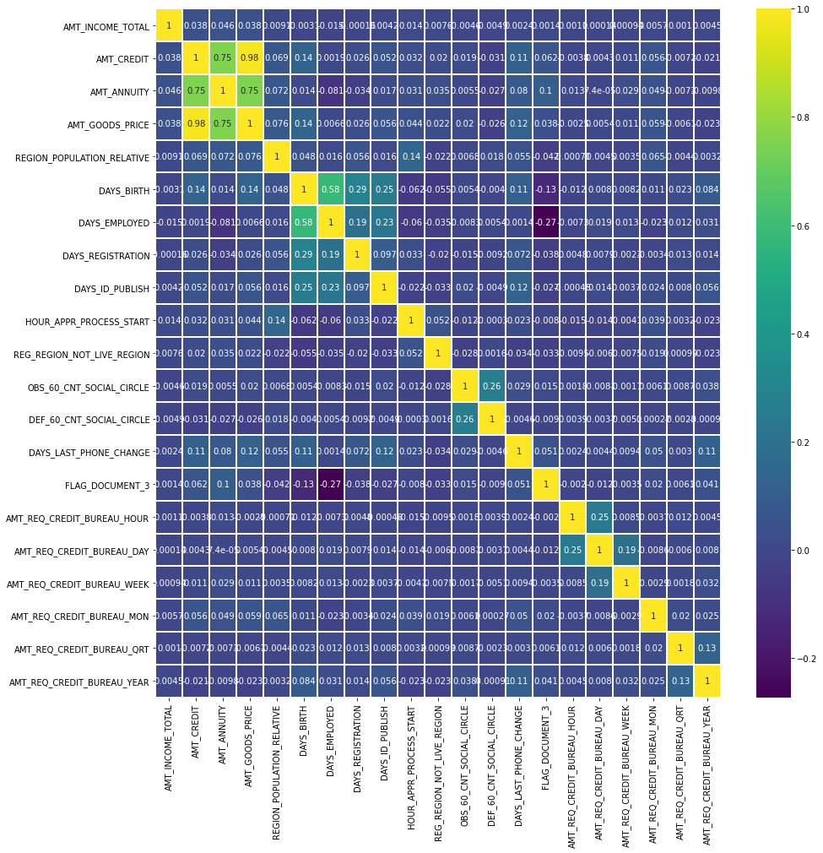
Inferences: Correlating factors amongst repayers
Credit amount is highly correlated with good price amount which is same as repayers.
Loan annuity correlation with credit amount has slightly reduced in defaulters(0.75) when compared to repayers(0.77)
We can also see that repayers have high correlation in number of days employed(0.62) when compared to defaulters(0.58).
There is a severe drop in the correlation between total income of the client and the credit amount(0.038) amongst defaulters whereas it is 0.342 among repayers.
Days_birth and number of children correlation has reduced to 0.259 in defaulters when compared to 0.337 in repayers.
There is a slight increase in defaulted to observed count in social circle among defaulters(0.264) when compared to repayers(0.254)

Slide 22
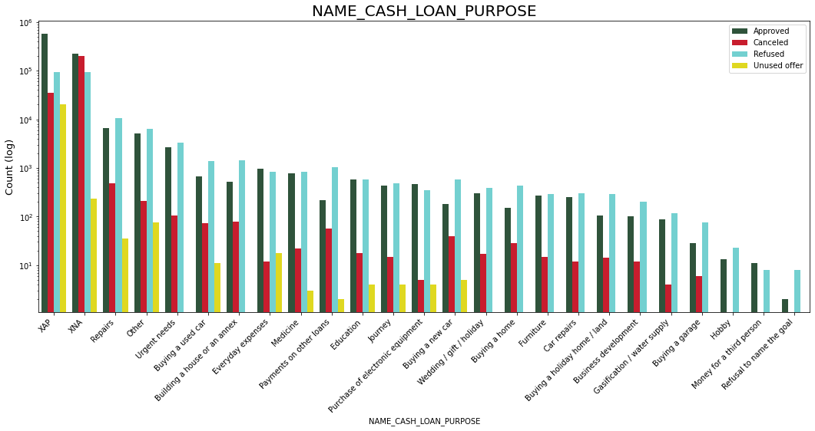
5. Merged Dataframes Analysis
Fig : Plotting Contract Status vs purpose of the loan

Slide 23
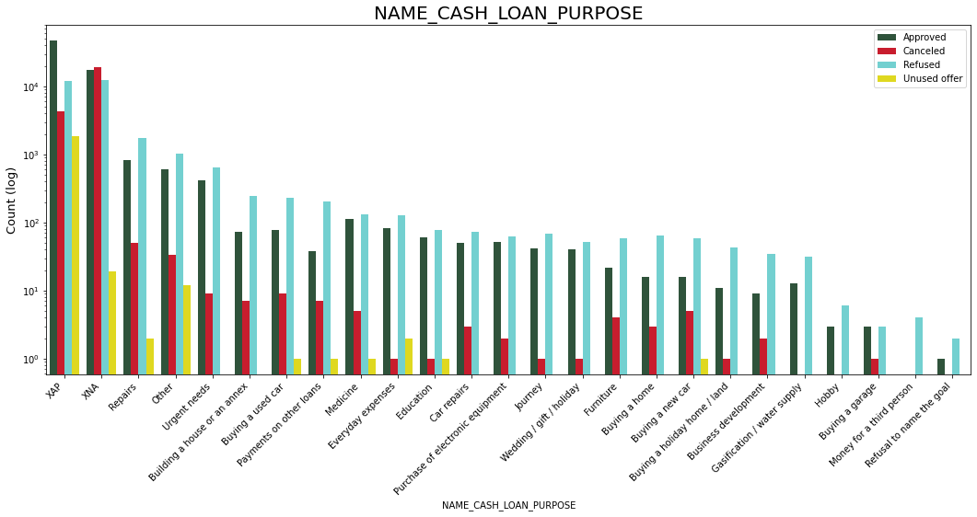
Inferences:
Loan purpose has high number of unknown values (XAP, XNA)
Loan taken for the purpose of Repairs looks to have highest default rate
Huge number application have been rejected by bank or refused by client which are applied for Repair or Other. from this we can infer that repair is considered high risk by bank. Also, either they are rejected or bank offers loan on high interest rate which is not feasible by the clients and they refuse the loan.

Slide 24
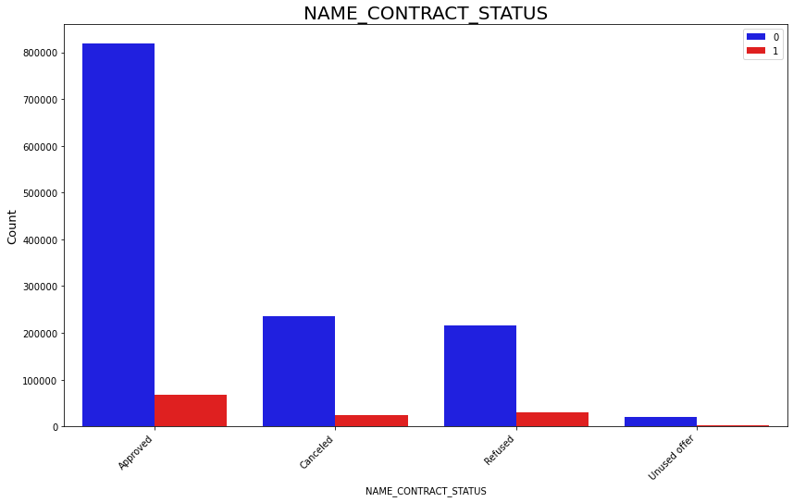
Checking Contract Status based on loan repayment status whether there is any business loss or financial loss:
Inferences:
90% of the previously cancelled client have actually repayed the loan. Revising the interest rates would increase business opportunity for these clients
88% of the clients who have been previously refused a loan has payed back the loan in current case.
Refusal reason should be recorded for further analysis as these clients could turn into potential repaying customer.

Slide 25
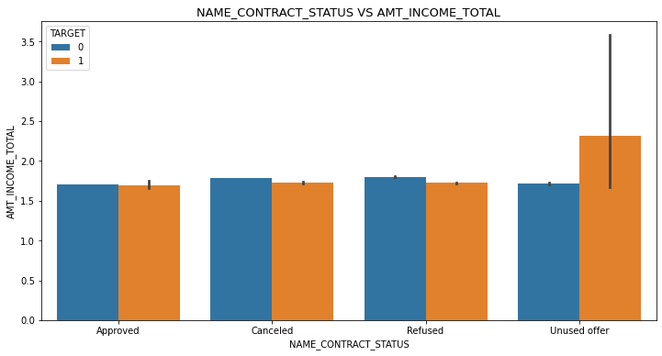
Plotting the relationship between income total and contact status:
Inferences:
The point plot show that the people who have not used offer earlier have defaulted even when there average income is higher than others

Slide 26
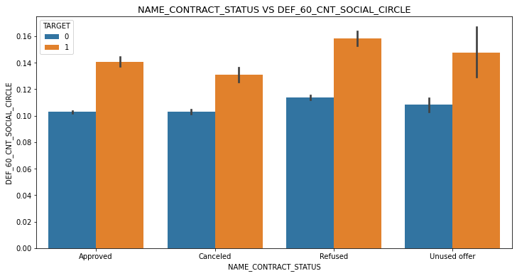
Plotting the relationship between people who defaulted in last 60 days being in client's social circle and contact status:
Inferences:
Clients who have average of 0.13 or higher their DEF_60_CNT_SOCIAL_CIRCLE score tend to default more and thus analysing client's social circle could help in disbursment of the loan

Slide 27
6. Conclusions
Depending on the deciding factors of applicant the bank would be able to identify if they will repay the loan or not.
(A) Deciding factor whether an applicant will be Repayer:
NAME_EDUCATION_TYPE: Academic degree has less defaults.
NAME_INCOME_TYPE: Student and Businessmen have no defaults.
REGION_RATING_CLIENT: RATING 1 is safer.
ORGANIZATION_TYPE: Clients with Trade Type 4 and 5 and Industry type 8 have defaulted less than 3%
DAYS_BIRTH: People above age of 50 have low probability of defaulting
DAYS_EMPLOYED: Clients with 40+ year experience having less than 1% default rate
AMT_INCOME_TOTAL:Applicant with Income more than 700,000 are less likely to default
NAME_CASH_LOAN_PURPOSE: Loans bought for Hobby, Buying garage are being repayed mostly.
CNT_CHILDREN: People with zero to two children tend to repay the loans.

Slide 28
(B) Decisive Factor whether an applicant will be Defaulter:
CODE_GENDER: Men are at higher default rate
NAME_FAMILY_STATUS : People who have civil marriage or who are single
NAME_EDUCATION_TYPE: People with Lower Secondary & Secondary education
NAME_INCOME_TYPE: Clients who are either at Maternity leave OR Unemployed
REGION_RATING_CLIENT: People who live in Rating 3 has highest defaults
OCCUPATION_TYPE: Avoid Low-skill Laborers, Drivers and Waiters/barmen staff, Security staff, Laborers and Cooking staff
ORGANIZATION_TYPE: Organizations with highest percent of loans not repaid are Transport: type 3 (16%), Industry: type 13 (13.5%), Industry: type 8 (12.5%) and Restaurant (less than 12%)
DAYS_BIRTH: Avoid young people who are in age group of 20-40
DAYS_EMPLOYED: People who have less than 5 years of employment
CNT_CHILDREN & CNT_FAM_MEMBERS: Client who have children equal to or more than 9
AMT_GOODS_PRICE: When the credit amount goes beyond 3 lakhs, there is an increase in defaulters.

